Slide 1
DOM Manipulation in JavaScript
Mirzoulugbek Yusupov

Slide 2
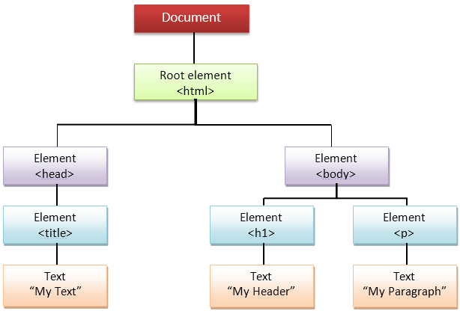
Introduction to the DOM
The Document Object Model (DOM) is a tree-like representation of an HTML document.
Each element, attribute, and text is a node in the DOM tree.
JavaScript can:
read,
modify
delete
create elements dynamically.

Slide 3
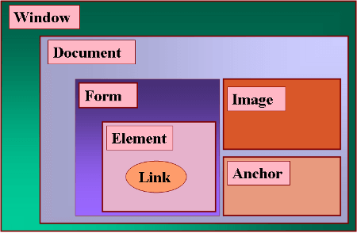
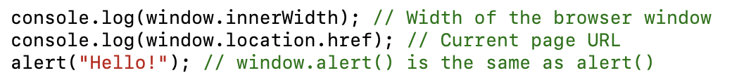
window objects
The window object is the global object in the browser. It represents the entire browser window and provides access to various functionalities including:
The DOM (document)
The BOM (Browser Object Model) like navigator, location, history
JavaScript functions and variables declared in the global scope

Slide 4
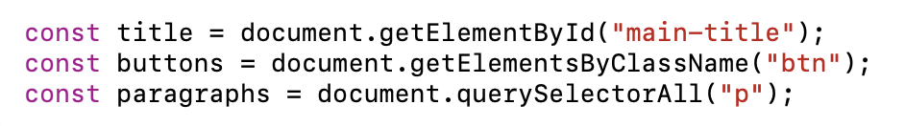
Accessing the DOM
document object represents the whole HTML document.
Common ways to select elements:
getElementById() – Selects an element by ID
getElementsByClassName() – Selects elements by class (returns HTMLCollection)
getElementsByTagName() – Selects elements by tag name
querySelector() – Selects the first matching element
querySelectorAll() – Selects all matching elements

Slide 5
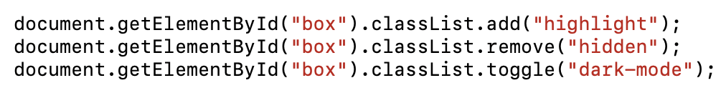
Modifying the DOM
Use innerHTML and textContent to modify an element’s content.
innerHTML processes HTML inside the element.
textContent only sets plain text.
Managing CSS Classes
classList.add("class") – Adds a class.
classList.remove("class") – Removes a class.
classList.toggle("class") – Toggles a class on/off.

Slide 6
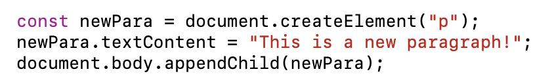
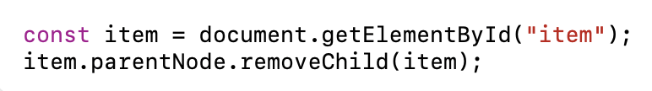

Creating & Deleting Elements
Creating New Elements
Use document.createElement() to create new elements dynamically.
Removing Elements
Use removeChild() or remove() to delete elements.

Slide 7
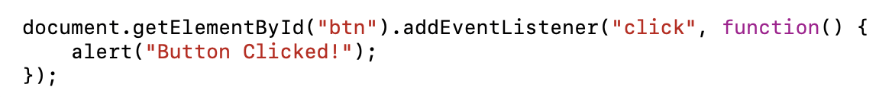
Event Handling in the DOM
Events occur when users interact with a webpage.
Common event types:
click – Button clicks
mouseover – Hovering over an element
keydown, keyup – Keyboard events
submit – Form submission
HTML DOM Events
The addEventListener() method allows us to attach event handlers.
Syntax:

Slide 8
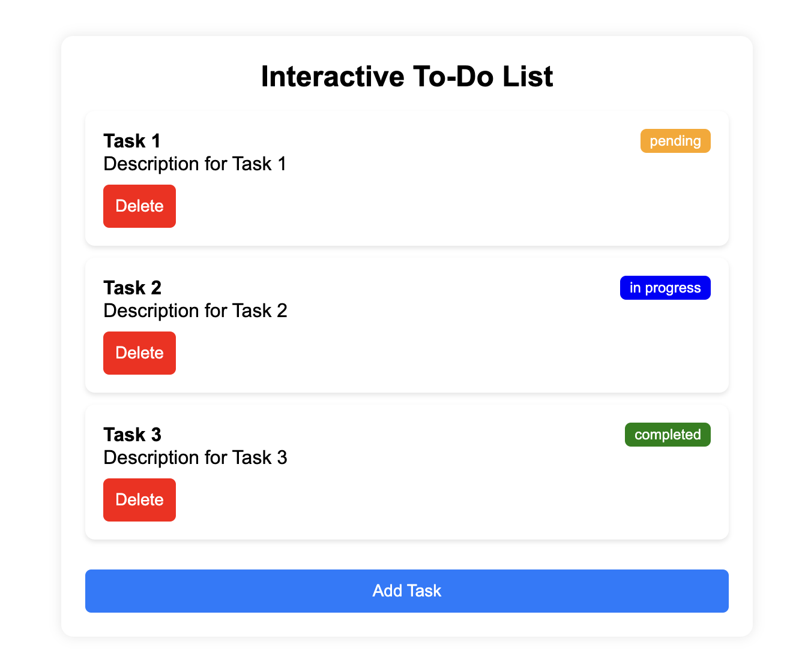
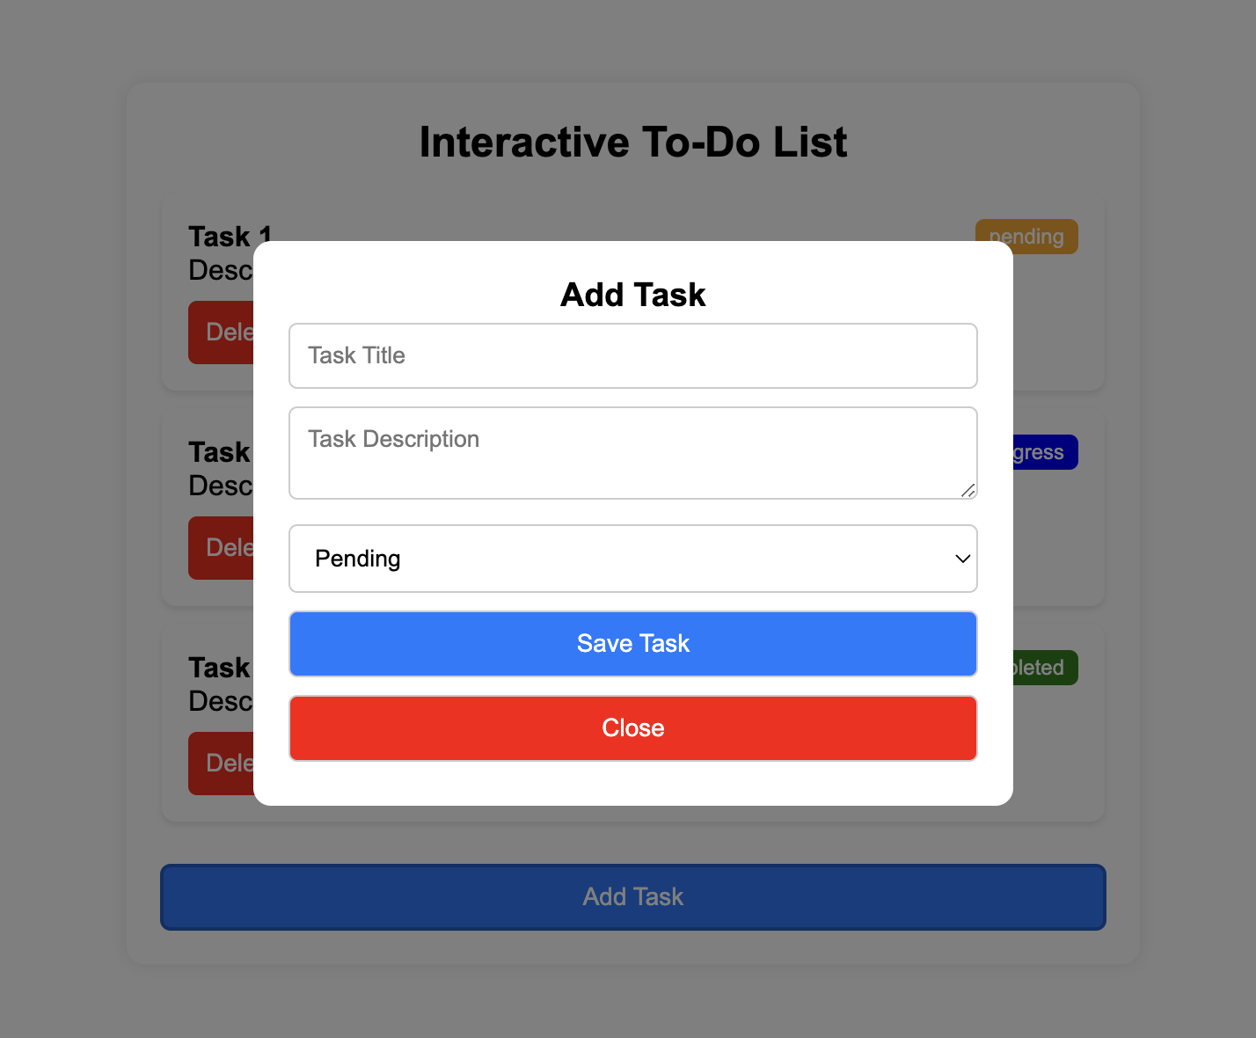
Practice - 1

Slide 9
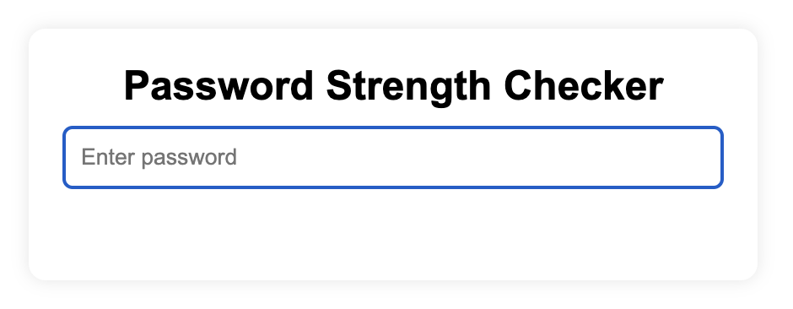
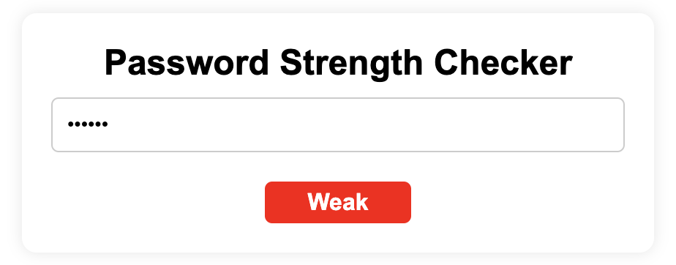
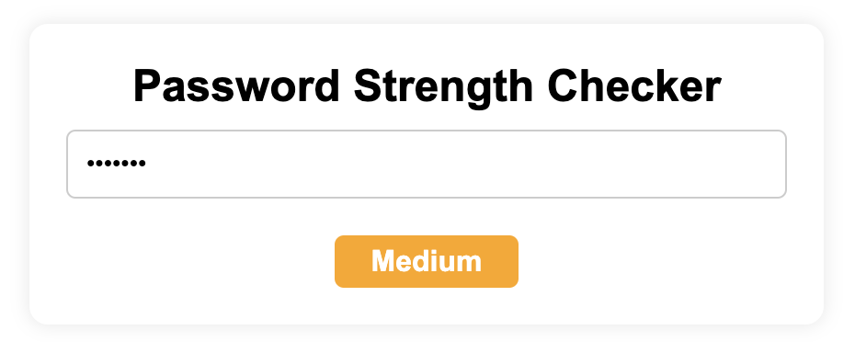
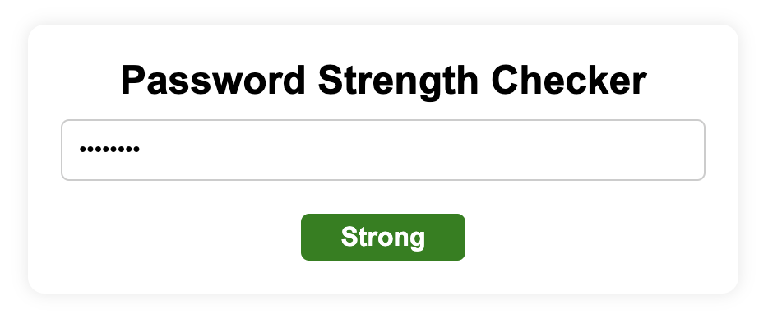
Practice - 2

Slide 10
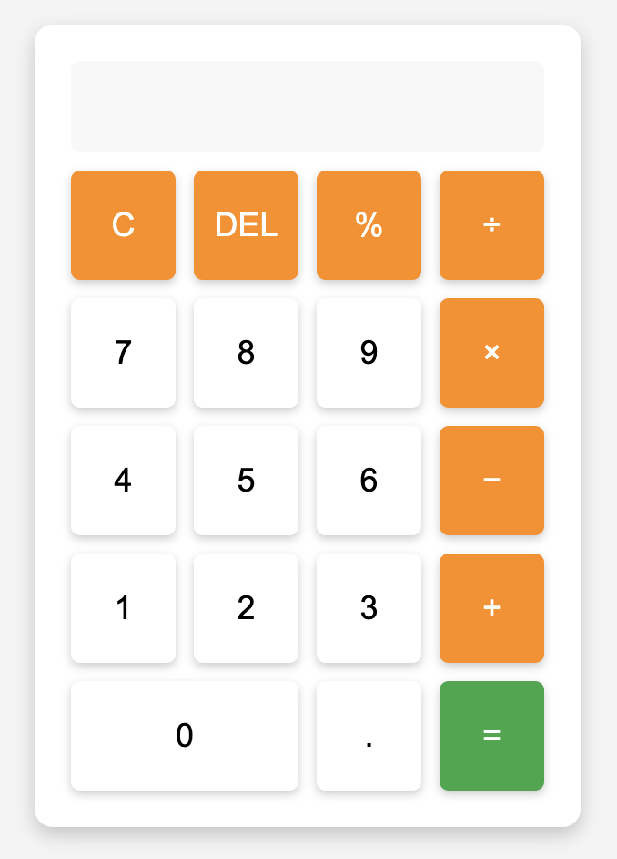
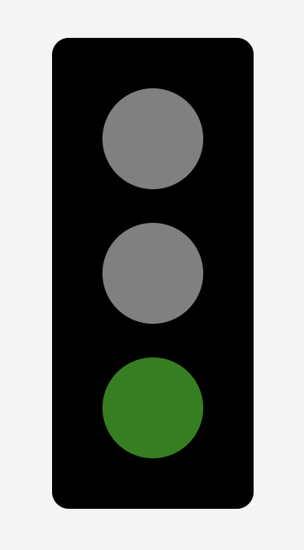
Practice – 3,4

Slide 11
Event Propagation
What is Event Propagation?
When an event occurs, it travels through the DOM tree in two phases:
Capturing Phase – The event moves from the root (document) to the target element.
Bubbling Phase– The event bubbles up from the target element to the root.
Why is this important?
Helps in handling nested event listeners efficiently.
Allows event delegation for dynamic elements.

Slide 12
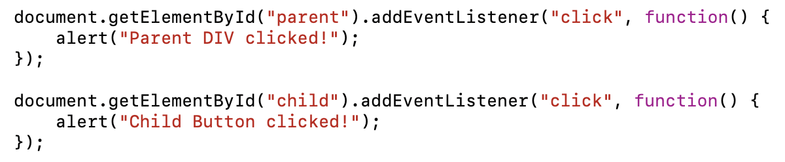
Event Bubbling
Bubbling: The event starts at the target element and moves up the DOM tree.
Example: Clicking on a <button> inside a <div> also triggers the <div>’s event.
💡 Clicking the child button triggers both alerts because the event bubbles up.

Slide 13
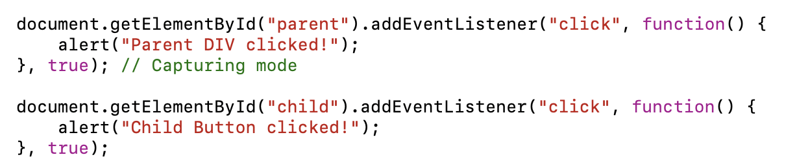
Event Capturing
Capturing (Trickling Down): The event moves from the document down to the target element before executing the event listener.
Pass true as the third argument in addEventListener().
💡 Here, the Parent DIV alert will show before the Child Button alert because capturing happens first.

Slide 14
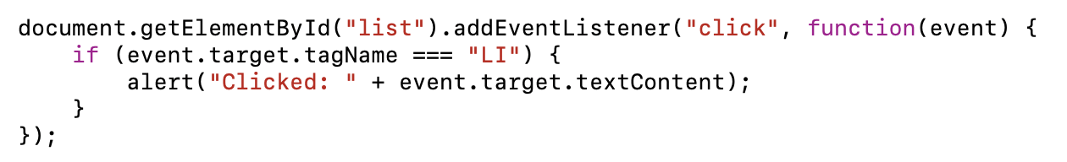
Event Delegation
Instead of adding event listeners to multiple elements, attach one to the parent.
Useful for dynamically added elements.
💡 Clicking any <li> triggers the alert without adding event listeners to each <li> manually.

Slide 15
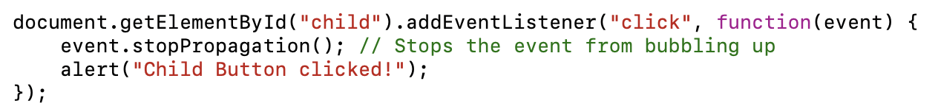
Stopping Event Propagation
Use event.stopPropagation() to prevent bubbling or capturing.
Example: Prevent parent div from receiving the event when clicking the button.
💡 Now, only the Child Button alert appears, and the parent div event is not triggered.

Slide 16
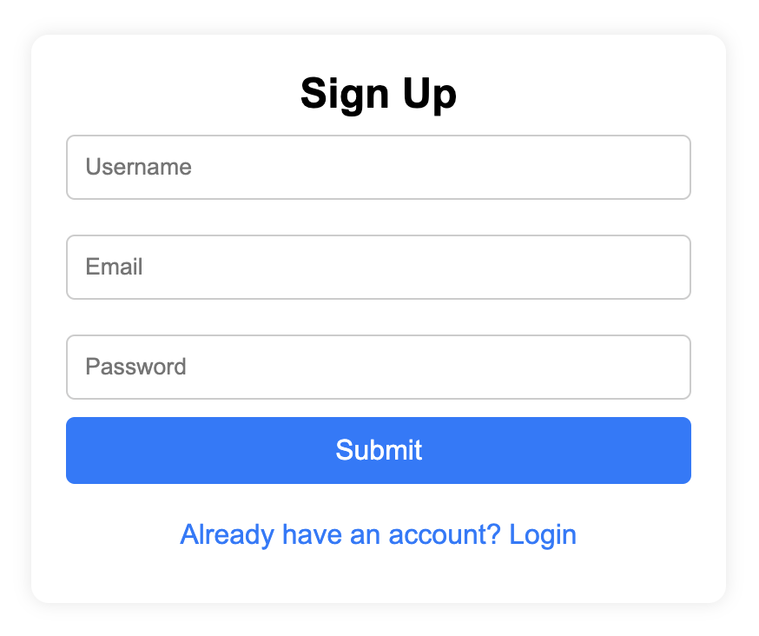
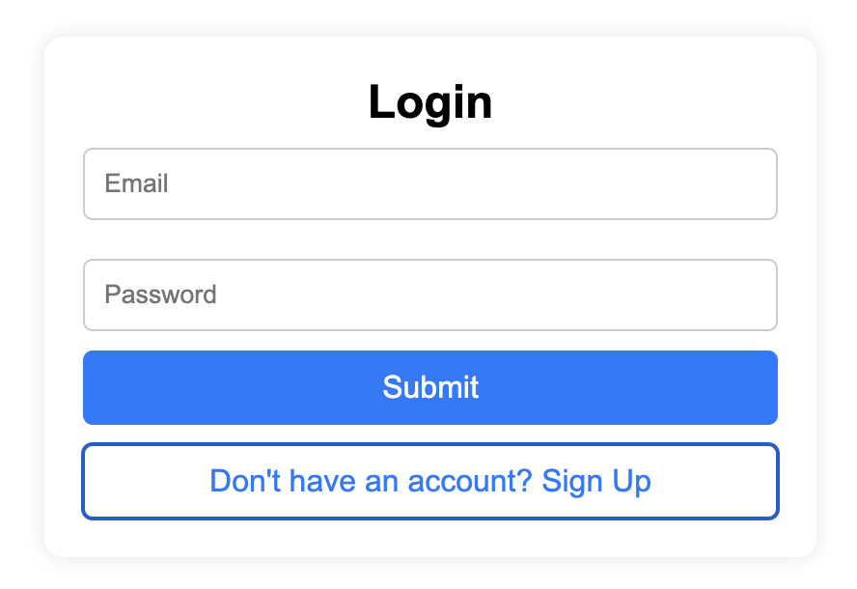
Homework 1

Slide 17
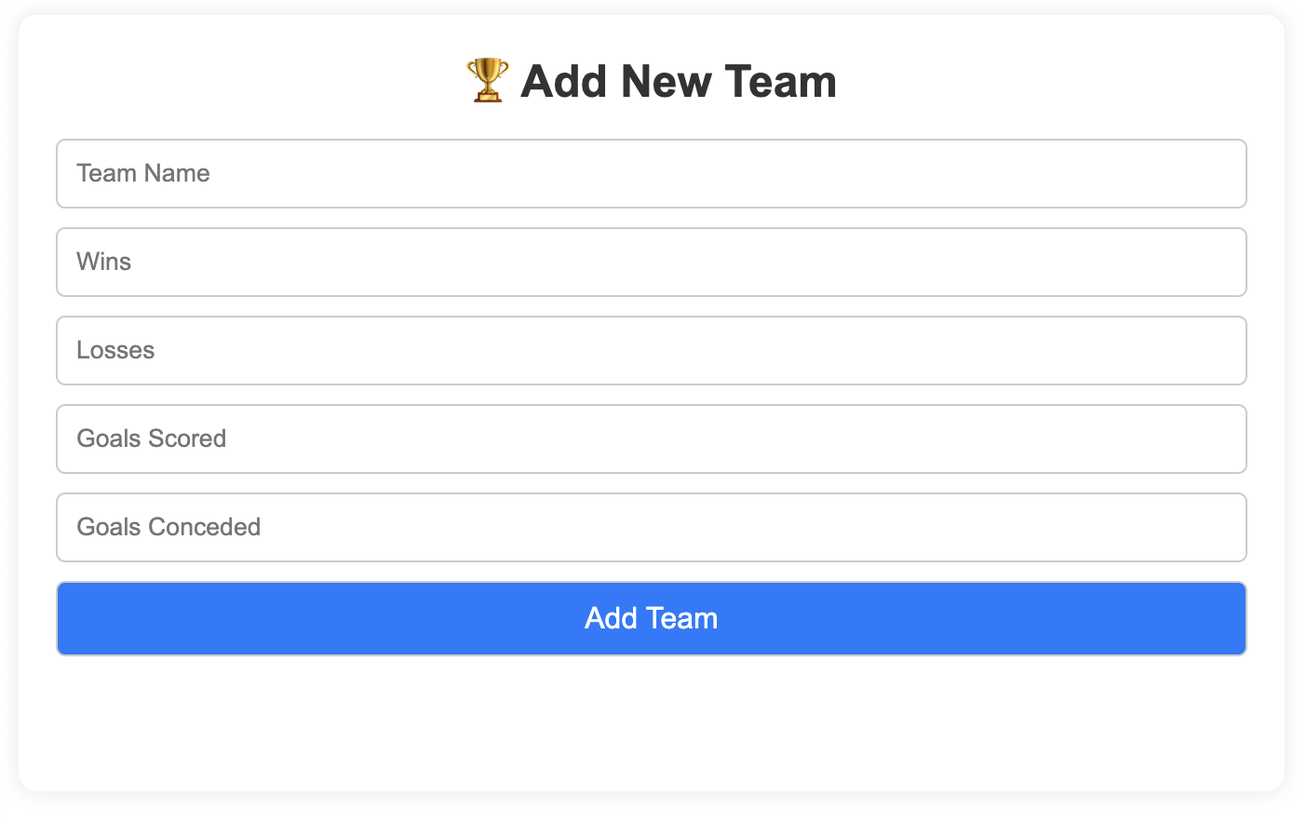
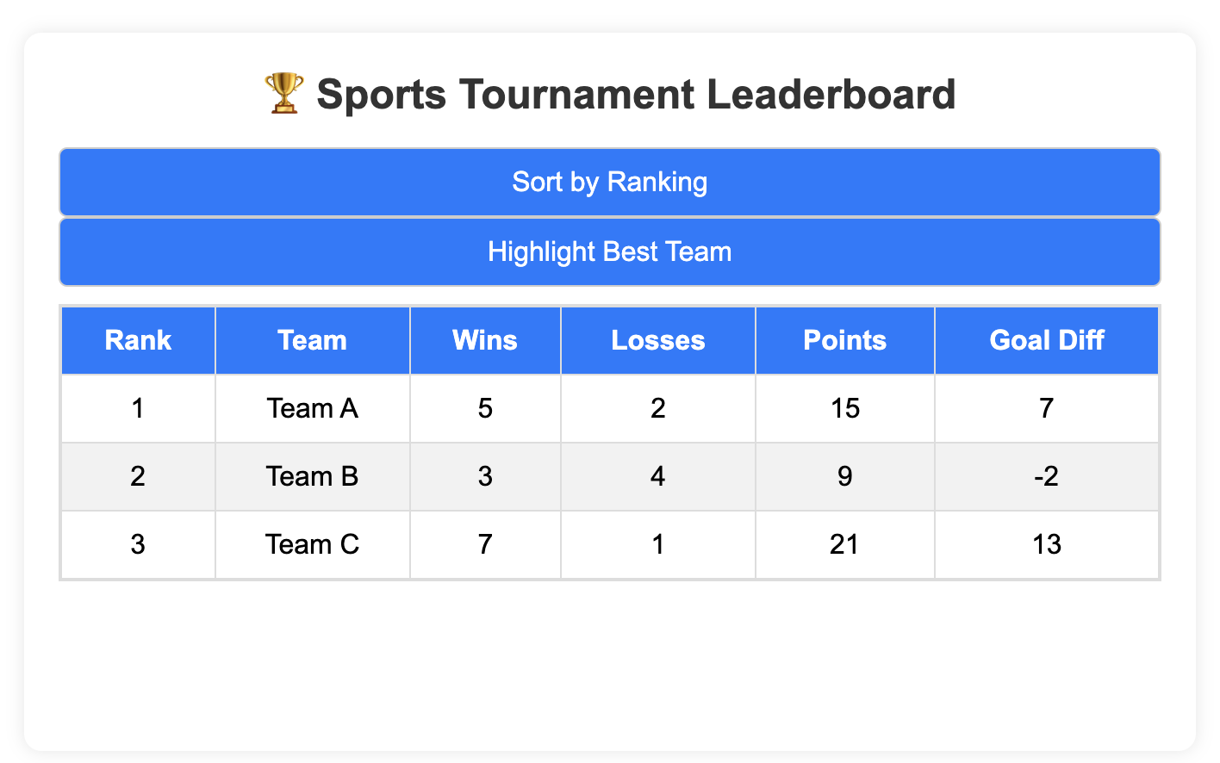
Homework 2

Slide 18
Thank You

